Slide 1




Unveiling Behavioral Transparency of Protocols Communicated by
IoT Networked Assets
Savindu Wannigama* Arunan Sivanathan⁺ Ayyoob Hamza⁺ Hassan Habibi Gharakheili⁺
*: Computer Engineering, University of Peradeniya, Sri Lanka
⁺: Electrical Engineering and Telecommunications, UNSW Sydney, Australia

Slide 2
Expanded Network Attack Surfaces
Rise of IoT devices has increased size and complexity of networks
  Led to expanded attack surfaces
To overcome new challenges, systematic approaches are needed for
  tasks like asset identification, vulnerability assessment, cyber risks management
Machine-readable descriptions can play essential roles in automation
  IETF MUD: specifying device functions on network; transport protocol/port & endpoint
  NTIA SBOM: inventory of software components and dependecies on devices

Slide 3
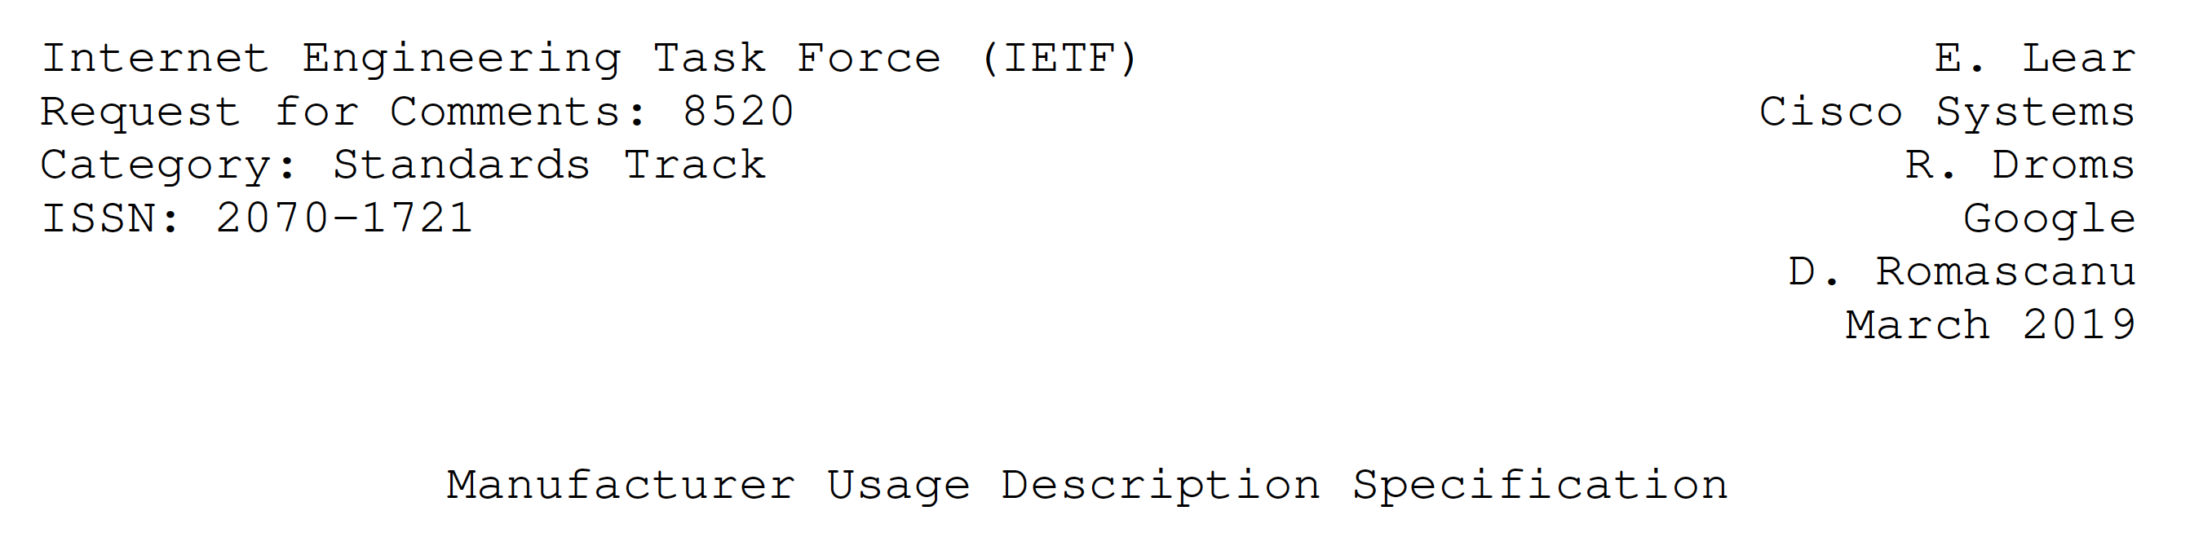
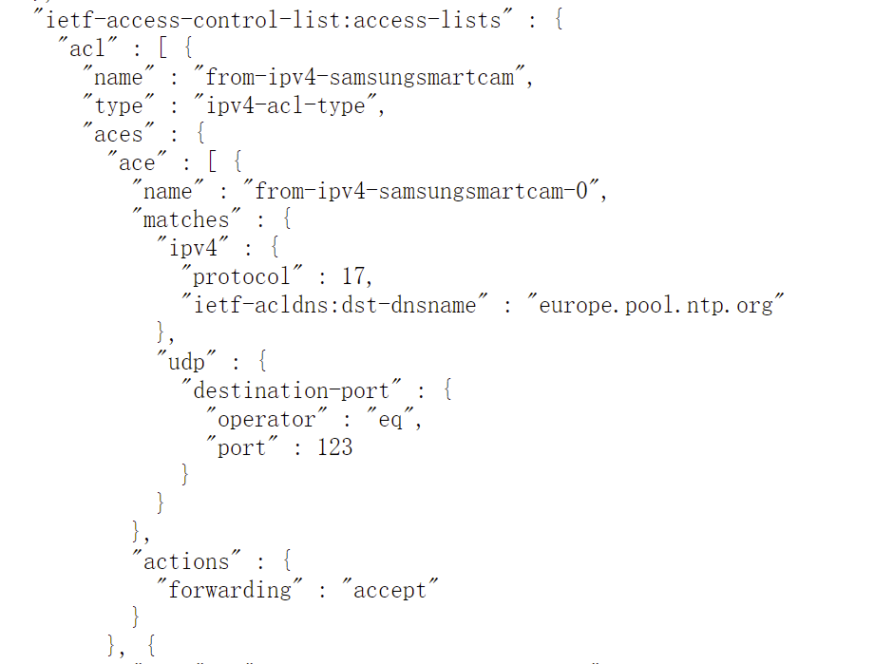
MUD
Sample MUD
UDP
server identity
service port (NTP)
action permitted

Slide 4
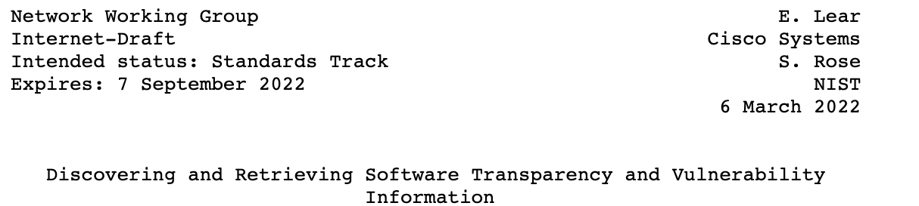
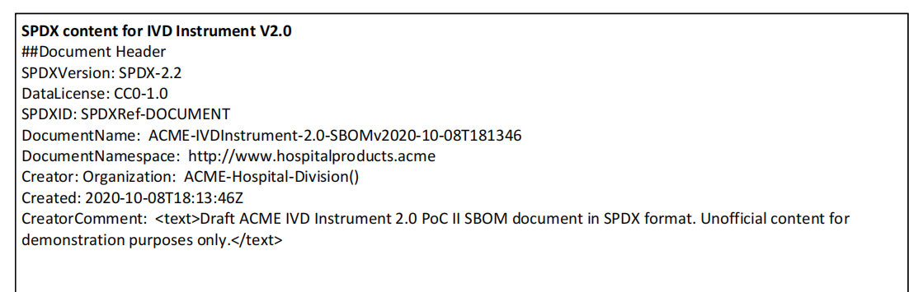
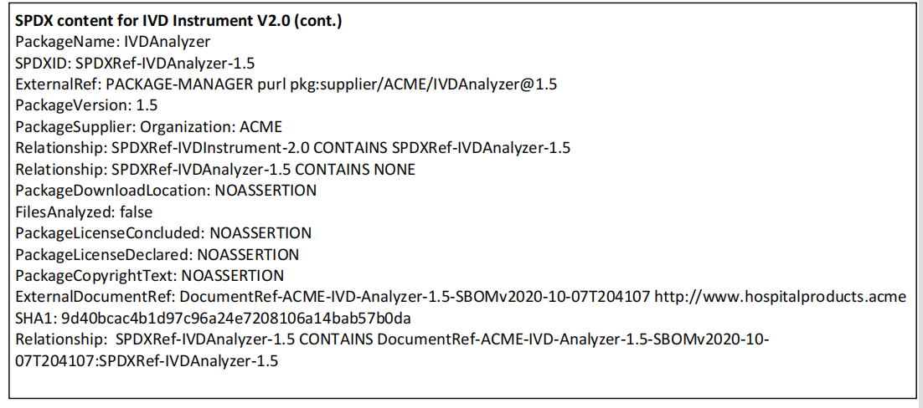
SBOM
Version
Author name
Component name
Version
Supplier name
Relationship
Component Hash

Slide 5
Gap
Network protocols, like HTTP, NTP, TLS, DNS, are vital to communications and operations
  lack of systematic and generalized visibility
Existing intrusion detection systems often:
  Rely on transport-layer port numbers to define protocols
    TCP/80 for HTTP
    UDP/123 for NTP
  Utilize proprietary signatures to inspect content of certain protocols
Our objectives
  systematically specifying and analyzing the characteristics and security parameters of various communication protocols

Slide 6
Intuitions
HTTP attributes (req & resp)
  “user-agent” (e.g., Mozilla/5.0, Microsoft-Windows, kindle/2.0)
  “request-version” specifies the message format (e.g., v1.0, v1.1, v2.0)
  “method” (e.g., GET, POST)
  “host”: address and port number
  “authentication-type” & “authentication-credential”
TLS attributes
  “client/server-hello-version” (e.g., v1.0, v1.1, v1.2, v1.3)
  “client/server-hello-cipher-suites” (e.g., hex code 0xc014 indicates TLS ECDHE RSA WITH AES 256 CBC SHA)
  “server-hello-certificate”

Slide 7
Our Contributions
We manually analyze packet traces of ten commercial IoT device types,
  focusing on two representative standard protocols: TLS (TCP/443) and HTTP (TCP/80)
  highlighting device specific fingerprints, and
    vulnerabilities in the parameters of these protocols
We develop a common model to describe signatures that help with the systematic analysis of protocols even communicated via non-standard ports
We evaluate the efficacy of our data models for six protocols
  TLS, HTTP, DNS, NTP, DHCP, and SSDP
  representing 97% of IoT network behaviors in our traffic traces
  draw insights into violations of security best-practices across protocols and device types

Slide 8
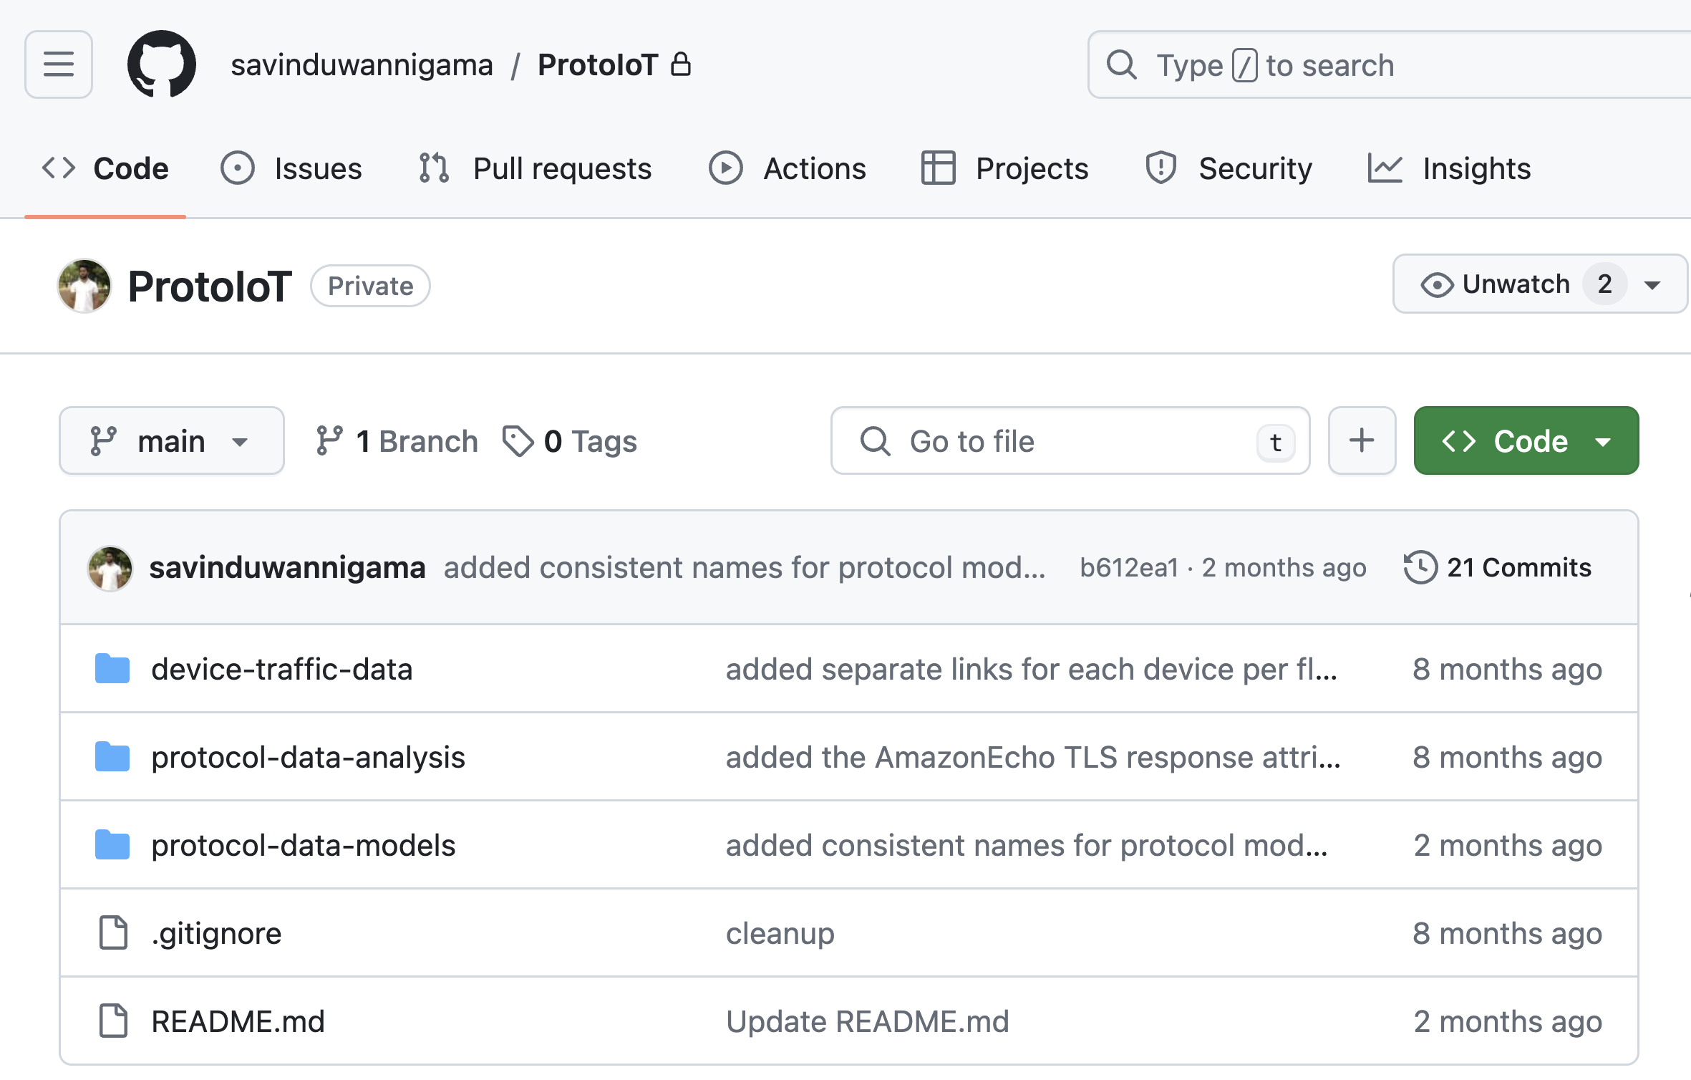
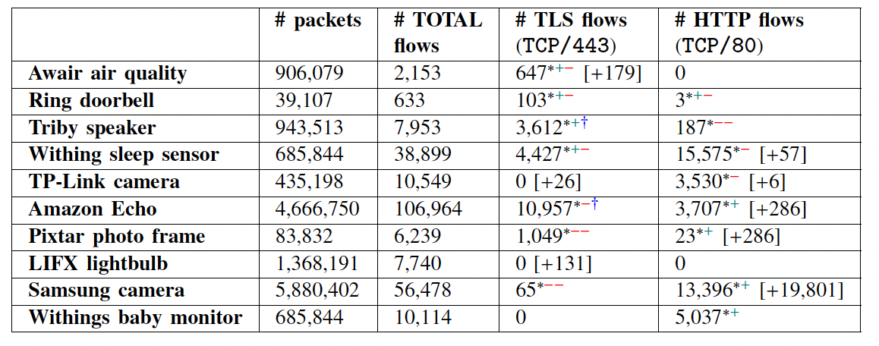

(1) Attributes and Vulnerabilities of Standard Protocols used by IoT Devices

Slide 9
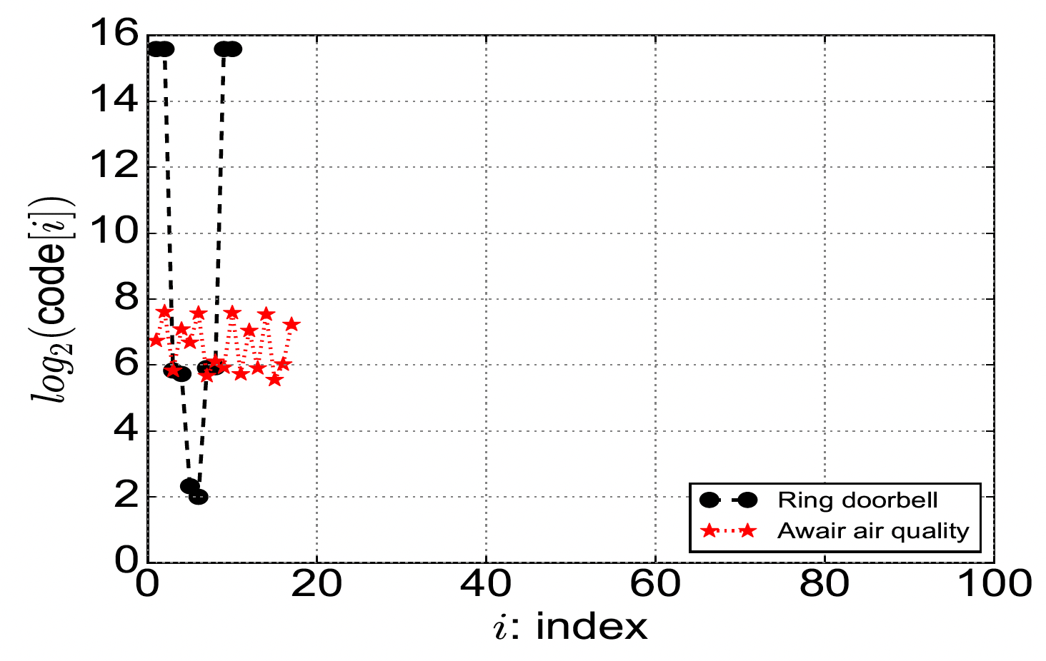
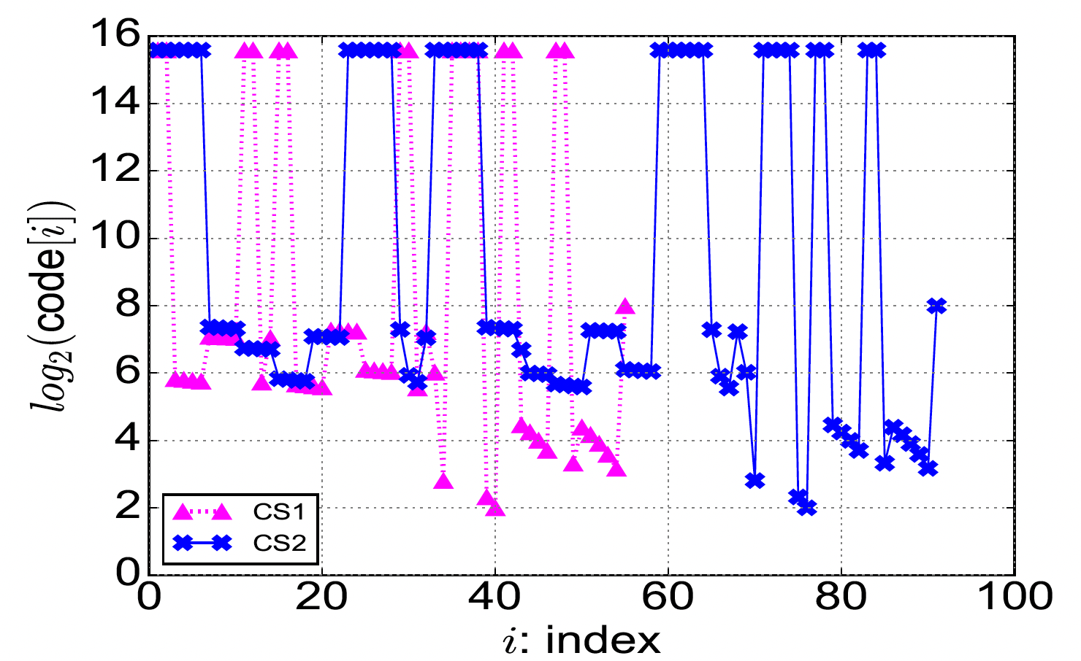
Selected Insights from TLS
Ring doorbell and Awair air quality
Amazon Echo
43 weak and 11 insecure codes
71 weak and 11 insecure codes

Slide 10
(2) Data Models for Protocols
A minimal schema
Help developers select parameters
Enable enforceable policies
Can be used for anomaly detection
Provided by community
  Used with MUD files

Slide 11
(3) Realizing Protocol Data Models
We created the data model for six commonly used IoT protocols
  TLS, HTTP, DNS, NTP, DHCP, and SSDP

Slide 12
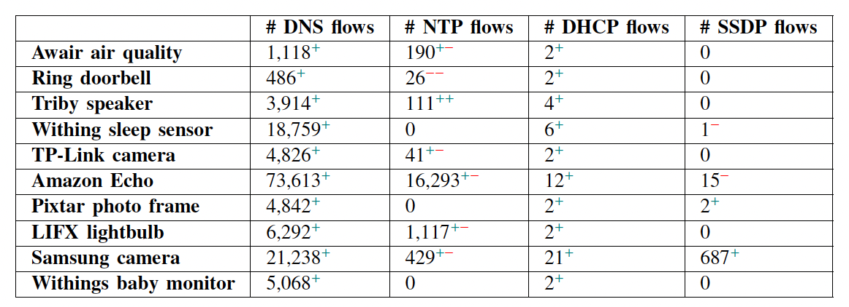
Impact of protocol data models
Detected HTTP and TLS communicated via non-standard port numbers
  TLS:
    TCP/56700 by lightbulb traffic
    TCP/50443 by camera
    TCP/8883 by Awair air quality
  HTTP:
    TCP/7888 by sleep sensors
    TCP/8080 by camera
    TCP/49153 & TCP/49154 by Amazon Echo
    TCP/49152 & TCP/5000 by photo frame

Slide 13
Conclusion
IoT devices expand network attack surfaces and often remain unmanaged
  Gaining systematic visibility into their behavior is crucial for managing cyber risks
We developed a machine-processable data schema to formally specify protocol signatures
  enabling systematic traffic analysis.
We evaluated the data models of six protocols (TLS, HTTP, DNS, NTP, DHCP, and SSDP)
  applying them to IoT traces
  highlighted vulnerabilities in protocol parameters on both standard and non-standard ports.
We publicly released our traffic traces and data models

Slide 14
Thanks for your attention ☺
Hassan Habibi Gharakheili h.habibi@unsw.edu.au
More data and tools can be found on our research website: https://iotanalytics.unsw.edu.au/

